Slide 1
Crew Pairing and Rostering
Crew Pairing and Rostering is key to better customer experience on flight and operational efficiency of the trips; it is highly critical to have right mix of crew members to manage cost and fatigue. Airlines companies continuously strive to produce a better model to pair crew for a particular flight based on various parameters, but it is still evolving, and best solution is far away from the reach of the companies

Slide 2
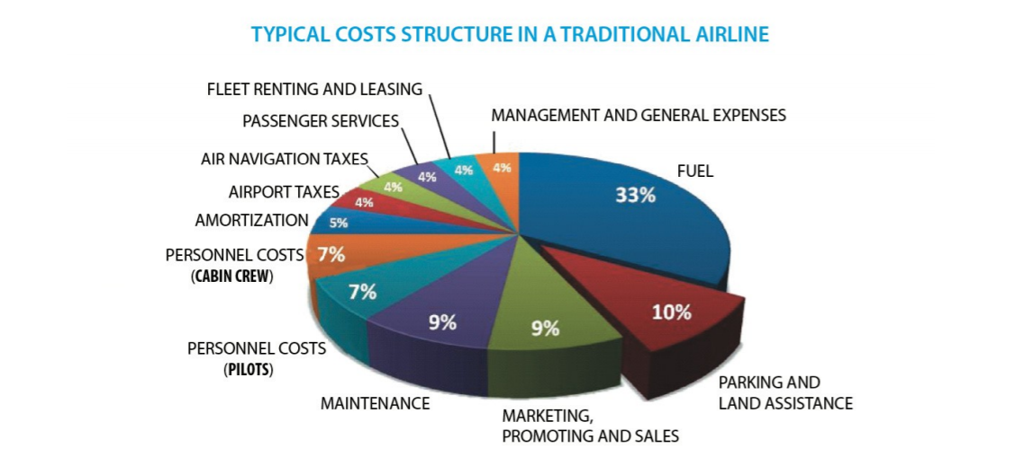
Introduction
Personal Costs (Cabin Crew) = 7%
Personal Costs (Pilots) = 7%
Total Personal Costs = 14%
Second highest after Fuel Costs
This data can be found in the Spanish Government Department “Ministerio de Fomento”

Slide 3
Approach
Flight
Timetable
Crew
Pairings
Crew
Rosters
Crew
Schedules
Optimization Problem
Problem sub dividing –
a) Optimizing Crew Pairing
b) Optimizing Crew Rostering
Both the problems complement each other.

Slide 4
Features
Key Data Dimensions
Objectives
Costs
Crew Bids
Robustness
Etc.
Rules
Rest Times
Days Off
Hours Limitations
Qualification Rules
Etc.
Activities
Training
Ground Duties
Reserves
Etc.
Crew
History
Qualification
Vacation
Medical Emergencies
Etc.

Slide 5
Source
Feature Relationship
Arrival
Destination
Departure
Time
Flight
Timetable
Flight
Timetable
Arrival time before Departure
Turnaround between paired flights
Flight Timetable
Constraints
Date Continuity between pairing flights
Crew
Rostering
Destination Airport is Origin Airport of next flight
Max days in pairing
Crew
Pairing
Training/
Ground Duty
Crew Related
Constraints
Maximum Flight hours in a day
Vacation/
Sick
Personal History
Round Trip Duration

Slide 6
Machine Learning Model Evaluation
Assumptions –
The objective function is Minimization Optimization Problem i.e., personal cost of both cabin and crew by allocating optimum manpower in terms of crew pairing and rostering, hence minimizing overhead costs.
There are several constraints or restrictions- expressible in quantitative terms.
The relationship between objective function and constraints are linear.
The prices of input and output both are constant.
Minimization Linear Programing Problem –
Meets all the chief characteristics of LPP-
Clear Objective – The objective of this problem is to minimize the personal cost of both cabin and crew by allocating optimum manpower in terms of crew pairing and rostering, hence minimizing overhead costs.
Constraints – There is a clear list of constraints to start with (at least) the activities.
Non-Negativity – The value of the variables associated with the problem statement will never be negative.
Linearity – There is distinct relationship between the determining attributes of the problem.
Finiteness – Finite number of inputs and outputs.

Slide 7
Machine Learning Model Evaluation
Other Optimization Algorithm –
Travelling Salesman Problem – determining the shortest path using flight graph, by minimizing total crew cost by effectively scheduling flights and hence reducing overnight stay in hotels, deadhead time and sitting times.
Stochastic Optimization Algorithm
Optimization using hybrid approaches – combining two/more different optimization models or optimization and supervised models.
Multi-start methods for combinatorial optimization
Unsupervised Models –
Clustering Models – KNN Decision Tree etc. for descriptive analysis.
Supervised Models –
Regression/Ensemble Models – Linear Regression, Random Forest etc. for inferential analysis

Slide 8
Role Of Optimization
Any ML or AI Model applied has to combined with Optimization Model, so as to achieve effective solution for the Crew Pairing and Rostering Problem Statement.
Why Optimization -
Aids logical thinking and helps in providing better insight into the business problem.
An iterative process, which can be adjusted with changing conditions. Hence, easy to best solution with the help of LP by evaluating the cost and profit of various alternatives.
Provides an information base for optimum alloca­tion of scarce resources.
Helps in solving multi-dimensional problems.

Slide 9
Thank You!

